Slide 1
CPU Scheduling
Kriti MATHUR

Slide 2
CPU Scheduling
Basic Concepts
Scheduling Criteria
Scheduling Algorithms
Thread Scheduling
Multiple-Processor Scheduling
Operating Systems Examples
Algorithm Evaluation

Slide 3
Objectives
To introduce CPU scheduling
To describe various CPU-scheduling algorithms
To discuss evaluation criteria for selecting a CPU-scheduling algorithm for a particular system

Slide 4
Basic Concepts
CPU scheduling is the basis of multiprogramming.
Success of CPU scheduling depends upon some observed properties of process.
Process execution consists of a CPU execution and IO wait. Process alternates between these two states.
CPU burst: controlled by CPU(execution).
IO burst: controlled by IO(execution).
Process execution begins with CPU burst. This is followed by IO wait. Then another CPU burst and IO burst and so on. Eventually CPU burst will end with the system request to terminate execution.
CPU scheduler : when CPU becomes idle OS must select one of the processes from the ready queue to be executed. (short term scheduler)

Slide 5

Alternating Sequence of CPU And I/O Bursts

Slide 6
CPU Scheduler
Selects from among the processes in memory that are ready to execute, and allocates the CPU to one of them
Preemptive
Non-preemptive

Slide 7
Dispatcher
Dispatcher module gives control of the CPU to the process selected by the short-term scheduler; this involves:
  switching context
  switching to user mode
  jumping to the proper location in the user program to start/restart that program
Dispatch latency – time it takes for the dispatcher to stop one process and start another running

Slide 8
Scheduling Criteria
CPU utilization – keep the CPU as busy as possible
Throughput – # of processes that complete their execution per time unit
Turnaround time – amount of time to execute a particular process
Waiting time – amount of time a process has been waiting in the ready queue
Response time – amount of time it takes from when a request was submitted until the first response is produced, not output (for time-sharing environment)

Slide 9
Scheduling Algorithm Optimization Criteria
Max CPU utilization
Max throughput
Min turnaround time
Min waiting time
Min response time

Slide 10
Algorithms
FCFS(First come first serve)
SJF(shortest job first)
Priority scheduling
Round robin scheduling
Multilevel queue
Multilevel feedback queue.

Slide 11
FCFS
First in, first out (FIFO), also known as first come, first served (FCFS), is the simplest scheduling algorithm. FIFO simply queues processes in the order that they arrive in the ready queue.
In this, the process that comes first will be executed first and next process starts only after the previous gets fully executed.

Slide 12
First-Come, First-Served (FCFS) Scheduling
Process Burst Time
P₁ 24
P₂ 3
P₃ 3
Suppose that the processes arrive in the order: P₁ , P₂ , P₃
The Gantt Chart for the schedule is:
Waiting time for P₁ = 0; P₂ = 24; P₃ = 27
Average waiting time: (0 + 24 + 27)/3 = 17
P₁
P₂
P₃
0
24
27
30

Slide 13
IMPORTANT FORMULA
Completion Time: Time at which process completes its execution.
Turn Around Time: Time Difference between completion time and arrival time. Turn Around Time = Completion Time – Arrival Time
TAT = CT - AT
Waiting Time(W.T): Time Difference between turn around time and burst time.
Waiting Time = Turn Around Time – Burst Time
WT= TAT – BT or TAT = WT + BT

Slide 14
FCFS is non preemptive. Once CPU has been allocated to a process that process keeps the CPU until it terminates or IO request comes. This is particularly troublesome for time sharing systems where each user needs to get a share of CPU at regular intervals. It would be disastrous to allow one process to keep CPU for an extended period.
Convoy effect short process behind long process. All processes are waiting for one big process to get off the CPU. This effect results in lower CPU utilization.

Slide 15
FCFS Scheduling (Cont)
Suppose that the processes arrive in the order
P₂ , P₃ , P₁
The Gantt chart for the schedule is:
Waiting time for P₁ = 6; P₂ = 0; P₃ = 3
Average waiting time: (6 + 0 + 3)/3 = 3
Much better than previous case
P₂
P₃
P₁
0
3
6
30

Slide 16
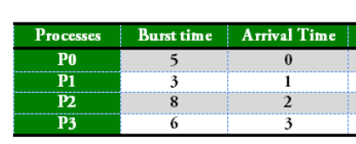
FCFS when different arrival time exist

Slide 17
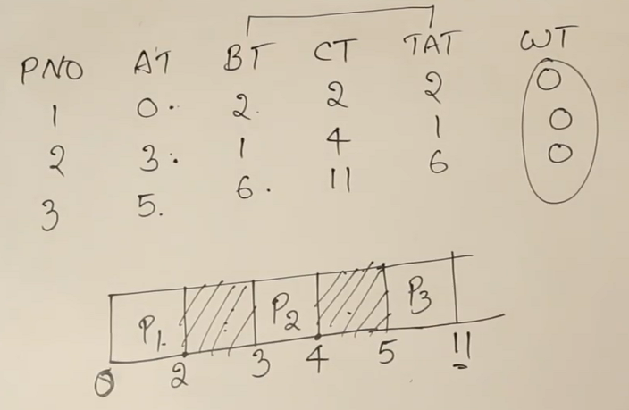
Case : check arrival time and burst time

Slide 18
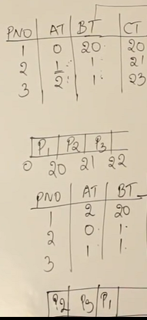
Convoy effect in SJF

Slide 19
Shortest-Job-First (SJF) Scheduling
Associate with each process the length of its next CPU burst. Use these lengths to schedule the process with the shortest time
SJF is optimal – gives minimum average waiting time for a given set of processes

Slide 20
Example of SJF
Process Arrival Time Burst Time
P₁ 0.0 6
P₂ 0.0 8
P₃ 0.0 7
P₄ 0.0 3
SJF scheduling chart
Average waiting time = (3 + 16 + 9 + 0) / 4 = 7
P₄
P₁
P₃
P₂
0
3
9
16
24

Slide 21
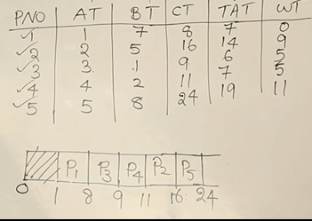

Slide 22
Shortest remaining time first (SRTF) or preemptive SJF
This Algorithm is the preemptive version of SJF scheduling. In SRTF, the execution of the process can be stopped after certain amount of time. At the arrival of every process, the short term scheduler schedules the process with the least remaining burst time among the list of available processes and the running process.
Once all the processes are available in the ready queue, No preemption will be done and the algorithm will work as SJF scheduling.
The context of the process is saved in the Process Control Block when the process is removed from the execution and the next process is scheduled. This PCB is accessed on the next execution of this process.

Slide 23
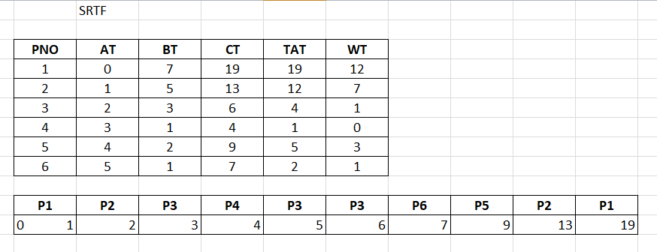
Shortest remaining time first (SRTF) or preemptive SJF

Slide 24
Pros:
Maximum throughput
Min waiting time and TAT
Cons:
The real difficulty with the SJF algorithm is knowing the length of the next CPU request.
For long term scheduler, SJF can be utilized.
Not implemented for short term scheduler as there is no way to predict the burst time.
Starvation to longer jobs

Slide 25
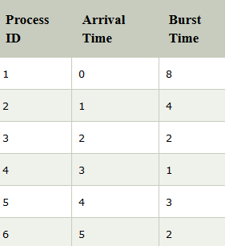
Practice problem SRTF ☺

Slide 26
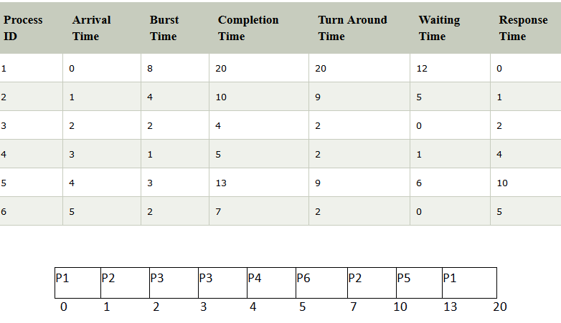
SRTF Practice problem solution

Slide 27
Priority Scheduling
A priority number (integer) is associated with each process
The CPU is allocated to the process with the highest priority
Equal priority processes are treated in FCFS manner.
No general agreement whether 0 is highest or lowest priority.
But in this we assume; (smallest integer ≡ highest priority)-> BUT CHECK PROBLEM !
Priorities can be defined internally or externally.
Internally defined priorities use some measurable quantities. Eg time limits, memory requirements, number of open files etc.
Externally: importance of the process and other political factors.

Slide 28
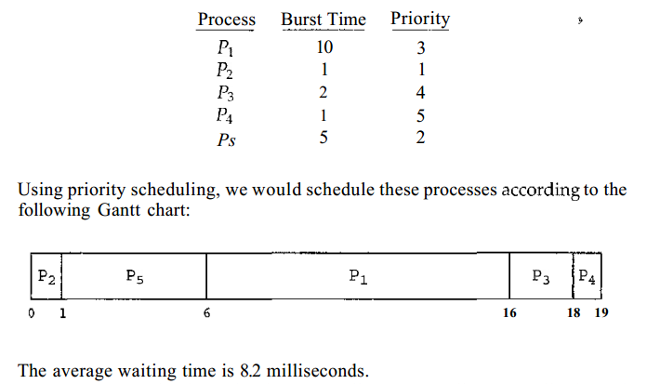
Priority Scheduling – Non preemptive case

Slide 29
  Preemptive will preempt the CPU if priority of newly arrived process is higher than the currently running process.
  Non-preemptive
SJF is a priority scheduling where priority is the predicted according to the shortest CPU burst time
Problem ≡ Starvation – low priority processes may never execute
Solution ≡ Aging – as time progresses increase the priority of the process

Slide 30
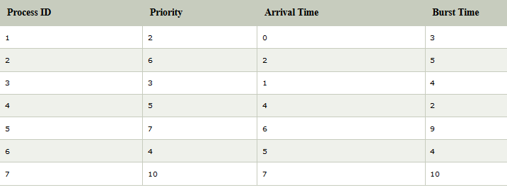

Practice problem priority scheduling

Slide 31
Round Robin (RR)
RR scheduling is specially designed for the time sharing systems.
It is similar to the FCFS scheduling but preemption is added to switch between the processes.
Each process gets a small unit of CPU time (time quantum), usually 10-100 milliseconds. After this time has elapsed, the process is preempted and added to the end of the ready queue.
New processes are added to the tail of the queue. CPU scheduler picks the first process from the ready queue, sets a timer to interrupt after 1 time quantum and dispatches the process.
RR approach is called processor sharing.

Slide 32
Example of RR with Time Quantum = 4
Process Burst Time
P₁ 24
P₂ 3
P₃ 3
The Gantt chart is:
Typically, higher average turnaround than SJF, but better response
P₁
P₂
P₃
P₁
P₁
P₁
P₁
P₁
0
4
7
10
14
18
22
26
30

Slide 33

Time Quantum and Context Switch

Slide 34
Multilevel Queue
It may happen that processes in the ready queue can be divided into different classes where each class has its own scheduling needs
Processes are easily classified into :
foreground
background
These two types of processes have different response time requirements and different scheduling needs.
Multilevel queue partitions ready queue into several queues.
  foreground – RR
  background – FCFS

Slide 35
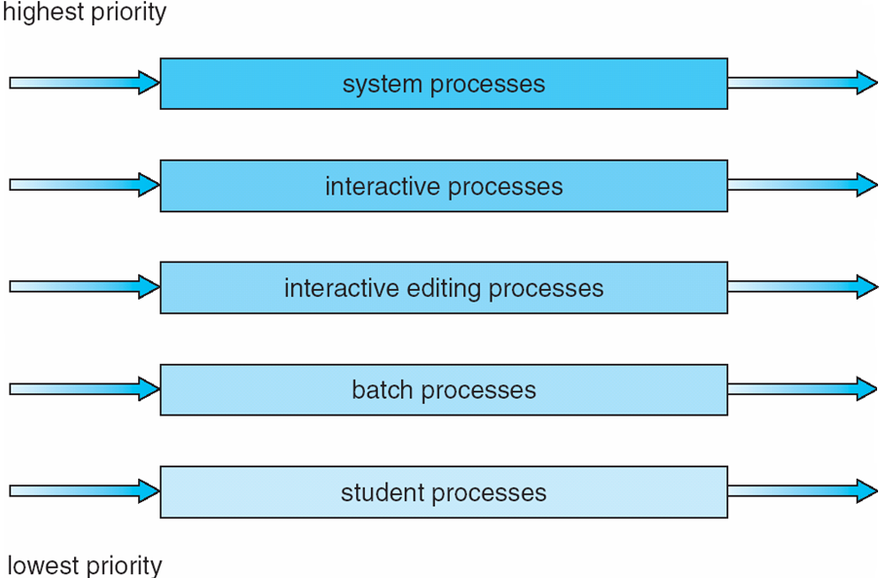
Multilevel Queue Scheduling
Ready Queue is divided into separate queues for each class of processes.

Slide 36
Multilevel Feedback Queue
In previous case processes are permanently assigned to a queue when they enter the system. Processes can not move from one queue to other.
A process can move between the various queues. Idea is to separate processes according to characteristics of CPU bursts. If process uses too much CPU time, it will be moved to the lower priority queue.
This scheme leaves IO bound and interactive process in higher priority queues.
Aging can be implemented this way. A process that waits too long can be shifted one level up.

Slide 37
Multilevel-feedback-queue scheduler defined by the following parameters:
  number of queues
  scheduling algorithms for each queue
  method used to determine when to upgrade a process
  method used to determine when to demote a process
  method used to determine which queue a process will enter when that process needs service

Slide 38
Example of Multilevel Feedback Queue
Three queues:
  Q₀ – RR with time quantum 8 milliseconds
  Q₁ – RR time quantum 16 milliseconds
  Q₂ – FCFS
Scheduling
  A new job enters queue Q₀ which is served FCFS. When it gains CPU, job receives 8 milliseconds. If it does not finish in 8 milliseconds, job is moved to queue Q₁.
  At Q₁ job is again served FCFS and receives 16 additional milliseconds. If it still does not complete, it is preempted and moved to queue Q₂.

Slide 39
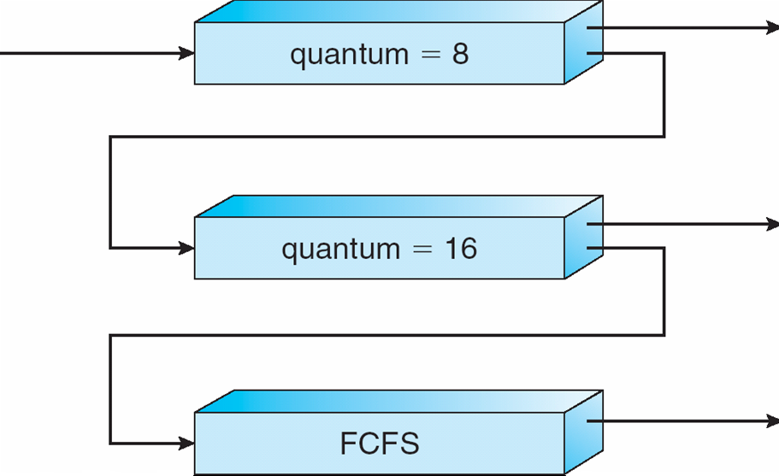
Multilevel Feedback Queues

